Slide 1

SQL
Session 1
Notes:
Hello Everyone. My name is ….... I will be your instructor for the SQL course. I hope everyone is healthy and ready for the session.
Alright, let’s start with PearDeck. Did you complete the pre-class activity?

Slide 2



Did you complete the pre-class activity?
Notes:
Hard or Easy
Use this template to do a quick temperature check and self-reflection about the homework. You can learn which students might have struggled with the assignment and therefore might need more attention today.
🍐 This is a Pear Deck Draggable™ Slide.
🍐 To edit the type of question, go back to the "Ask Students a Question" in the Pear Deck sidebar.

Slide 3
Table of Contents
What is a database?
What is in a database?
Structured Query Language (SQL)
SQL Language Elements
Notes:
Let’s get to know today’s session topics. We’ll start with the definition of a database. Then we’ll explore what is inside the database. Next, we’ll learn SQL (Structured Query Language) and its elements to communicate with the database.

Slide 4
What is a database?
1

Slide 5

Could you define
what the database is?
Notes:
Summarize
Have students write a quick, 1-2 sentence summary of the information they’ve just learned.
🍐 This is a Pear Deck Text Slide
🍐 To edit the type of question, go back to the "Ask Students a Question" in the Pear Deck sidebar.

Slide 6
What is a database?
“A database is an organized collection of data stored
in a computer system.”
Notes:
database concept is a general name given to systems where data is stored in a certain order.
Database is a regular collection of structured information or data that is usually stored electronically in a computer system.

Slide 7
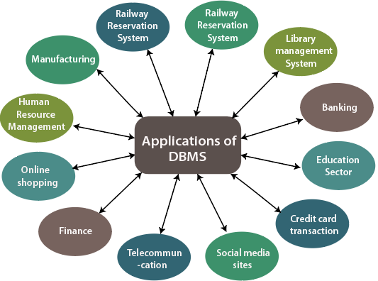
How are databases used in the real-world?
Notes:
Today, private or public institutions all keep the information they contain in their database. If the population directorates, transportation centers, banks, schools and universities can access the requested information within seconds from among the registered people, it is thanks to the database systems.
World is full of data. People use data and databases with or without awareness in their daily life activities.
our bank, your grocery store, an app on your cell phone, websites all use databases to keep track of your data. When you access a website, the website starts to collect your data (e.g. accessing date and time, your location, your browser info) and store it in its database.
Let's take another example. When you order a product on a commercial website, your order is stored in a database. You withdrew money from your bank account. Your bank stores this transaction in the database. Social media platforms such as Facebook, Instagram, Twitter use databases to store data like members, their friends, member activities, messages, advertisements, etc.

Slide 8
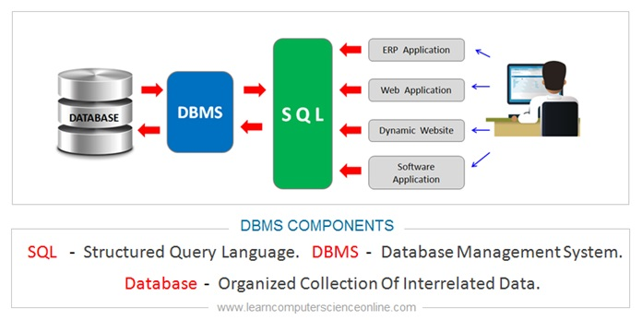
Database Management System
Database Management System
Language
Applications
Database
User

Slide 9



Database Management System
Notes:
A database is typically controlled by a database management system (DBMS). Data and DBMS along with the applications that are associated with them are called a database system, often shortened to just database.
There are different database management systems on the market according to companies’ need. You can see the most popular ones on the slide.

Slide 10
Types of Database Management System
Relational Database
Non-Relational Database
Notes:
A database is typically controlled by a database management system (DBMS). Data and Typically, there are two main database storage types:
A relational database is a type of database that stores and provides access to data points that are related to one another. Relational databases are based on the relational model, an intuitive, straightforward way of representing data in tables. The columns of the table hold attributes of the data, and each record usually has a value for each attribute, making it easy to establish the relationships among data points.

Slide 11

Types of Database Management System
Edgar Frank "Ted" Codd
(19 August 1923 – 18 April 2003)
English computer scientist
While working for IBM, invented the relational model for database management.
Notes:
Actually, the term "relational database" was invented by E. F. Codd at IBM in 1970. Codd introduced the term in his research paper "A Relational Model of Data for Large Shared Data Banks". In this paper and later papers, he defined what he meant by "relational". One well-known definition of what constitutes a relational database system is composed of Codd's 12 rules. However, no commercial implementations of the relational model conform to all of Codd's rules, so the term has gradually come to describe a broader class of database systems.

Slide 12
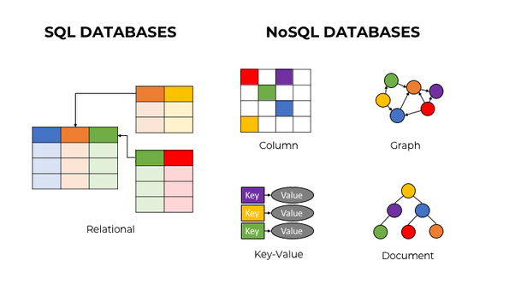
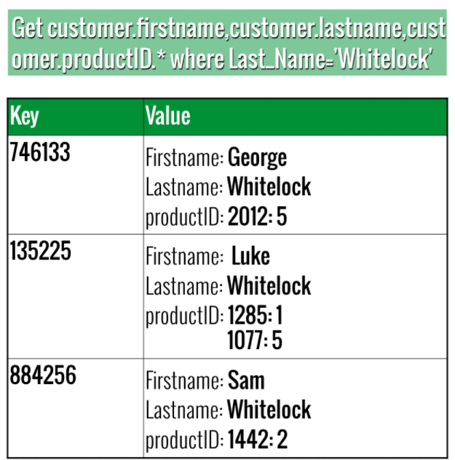
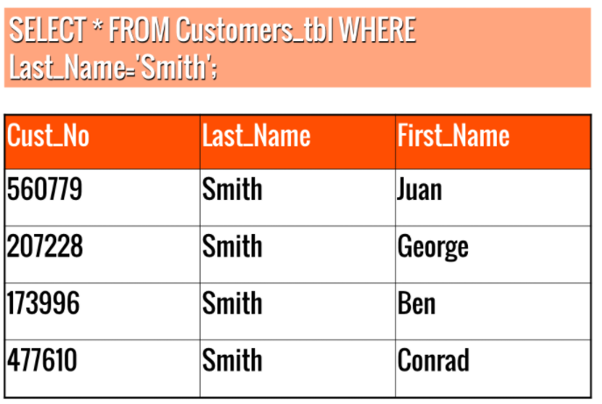
Types of Database Management System
Notes:
SQL (stands for Structured Query Language) is accepted as the standard Relational Database Management System (RDBMS) language. So we usually prefer to call Relational Database as SQL and Non-Relational database as NoSQL.
Left-> an example for SQL database and a query
Right-> an example for the NoSql Not Only SQL

Slide 13

“SQLite is a C-language library that implements a small, fast, self-contained, serverless, high-reliability, full-featured, SQL database engine. SQLite is the most used database engine in the world. SQLite is built into all mobile phones and most computers and comes bundled inside countless other applications that people use every day.”
Notes:
We will use SQLite as a relational database management system during on LMS during the pre-class. Whenever an SQL statement is present in the course, a SQL playground (on which you can run your SQL queries) is already embedded at the end of the lesson. You can try your queries on the SQL playground.
We also kindly request you to install DB Browser for SQLite to run the queries on your local machine. The installation process is very straightforward and easy. The setup file is just 16 MB.

Slide 14

PostgreSQL (also known as Postgres), is a free and open-source relational database management system (RDBMS) emphasizing extensibility and SQL compliance.
Notes:
We will use SQLite as a relational database management system during on LMS during the pre-class. Whenever an SQL statement is present in the course, a SQL playground (on which you can run your SQL queries) is already embedded at the end of the lesson. You can try your queries on the SQL playground.
We also kindly request you to install DB Browser for SQLite to run the queries on your local machine. The installation process is very straightforward and easy. The setup file is just 16 MB.
https://db-engines.com/en/ranking

Slide 15
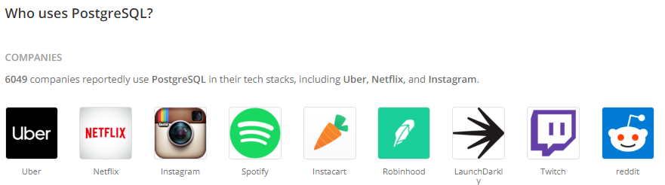
Who use PostgresSQL
Many companies have built products and solutions based on PostgreSQL. Some featured companies are Apple, Fujitsu, Red Hat, Cisco, Juniper Network, Instagram, etc.
Notes:
database concept is a general name given to systems where data is stored in a certain order.
Database is a regular collection of structured information or data that is usually stored electronically in a computer system.

Slide 16
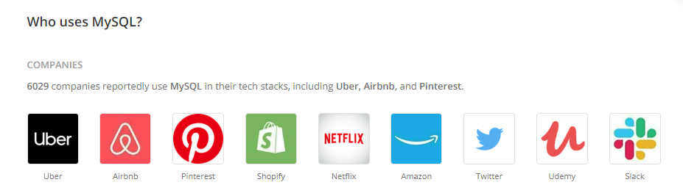
Who use PostgresSQL
Notes:
database concept is a general name given to systems where data is stored in a certain order.
Database is a regular collection of structured information or data that is usually stored electronically in a computer system.

Slide 17
What is in a database?
Notes:
Summarize
Have students write a quick, 1-2 sentence summary of the information they’ve just learned.
🍐 This is a Pear Deck Text Slide
🍐 To edit the type of question, go back to the "Ask Students a Question" in the Pear Deck sidebar.

Slide 18
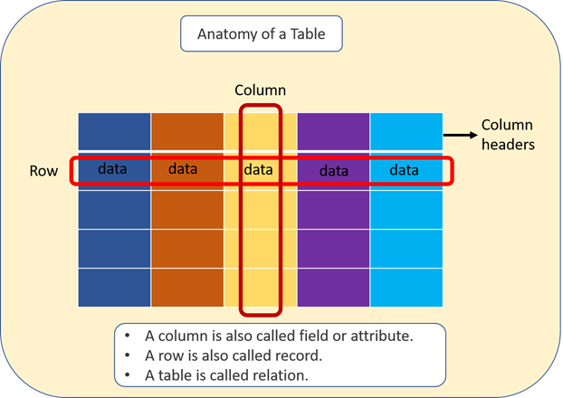
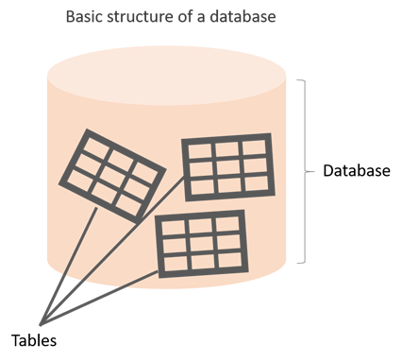
What is in a database?
Notes:
Herkes hayatının bir döneminde excel ile uğraşmıştır.
The information inside the database is grouped into tables.
A table in a database is called a database table.
Tables are the basic unit of data storage in databases.
We used the term structured data. Structured data here means table. A table consists of columns and rows. You may think of it as an Excel or Google spreadsheet. Although there are similarities between the database table and Excel/Google spreadsheet, they are different things. We won't get into details here. A table is made up of columns and rows. A column is a piece of data stored by the table. A row is a single set of columns that describe the attributes of a single thing. Columns should have a unique name. Columns and rows together make up a table.

Slide 19
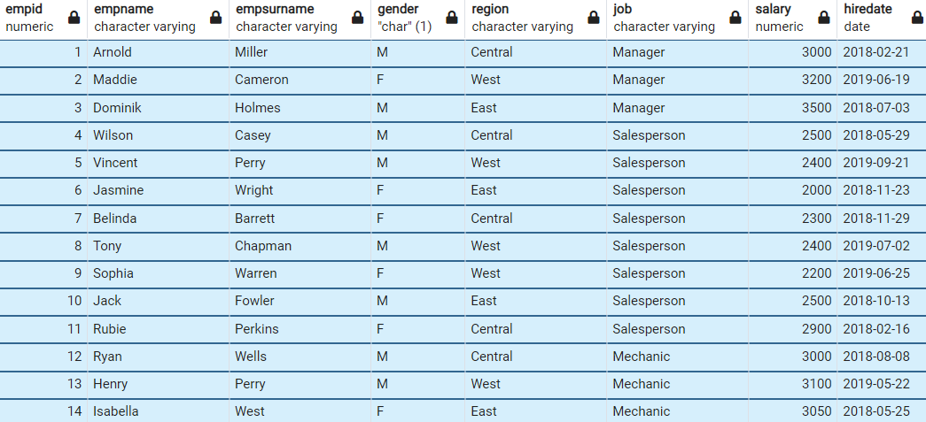
What is in a database?
employees table
Notes:
this is an example;
Let's take the case of a company database. Suppose that it has two tables. One is employees, and other is departments. Let’s take a closer look at the employees table. Here is the breakdown of the table.
Table's name is employees.
The table has seven columns (aka, fields or attributes)
The table has ten rows (aka, records or tuples)
Table's column header names are: emp_id, first_name, last_name, salary, job_title, gender, hire_date
Inside the employees' table, there is data about each employee in the company
Of course, a real-world company would have many more employees. We use a small table to illustrate concepts.
recap;
Q: What is a table, column and row?
A: A table is an organized collection of data (relational) stored in the form of columns and rows. Columns can be categorized as vertical and rows as horizontal. The columns in a table are called fields (attribute) while the rows can be referred to as records.

Slide 20
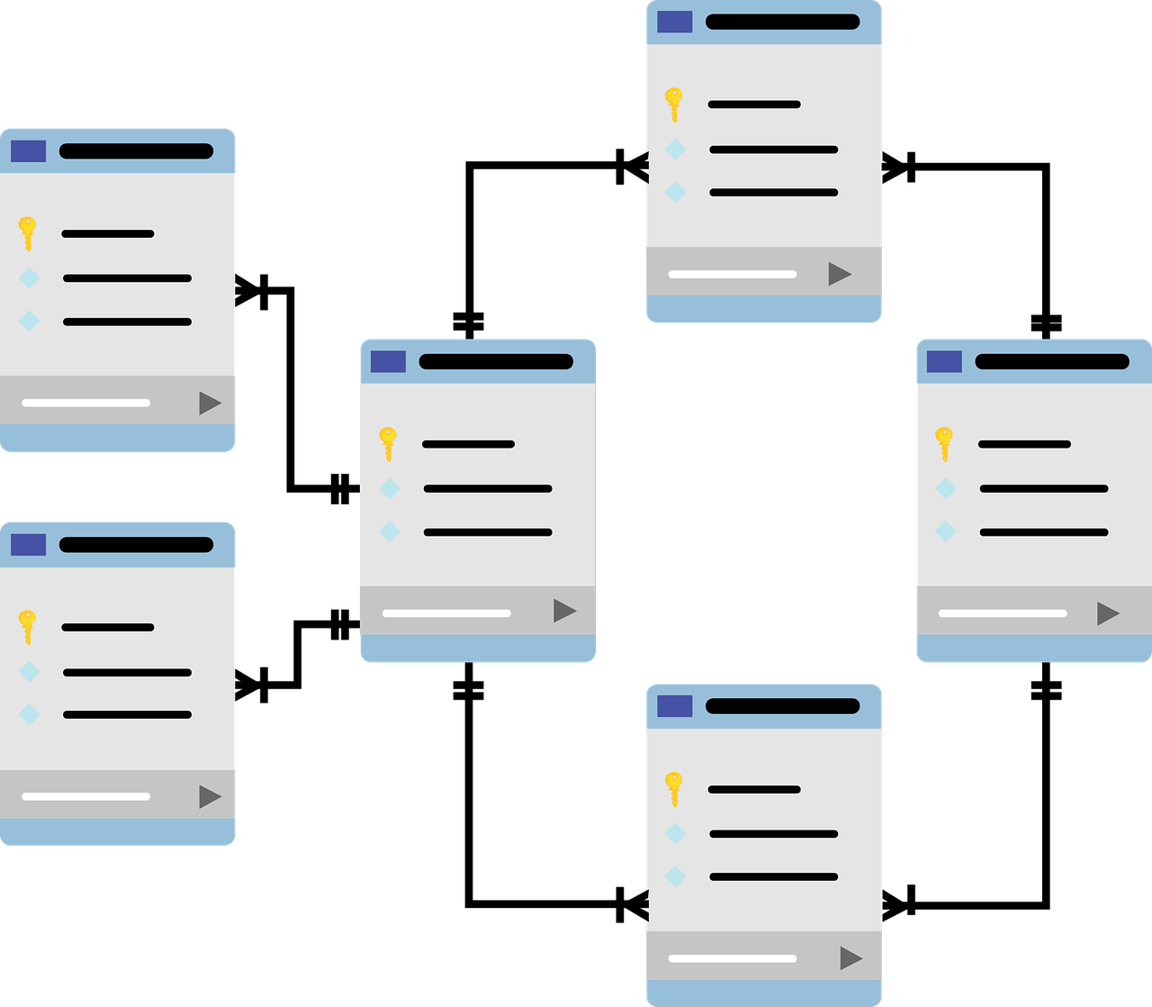
What is in a database?
Notes:
Now, it's time to communicate with our database with SQL.
Please remember, the purpose of this course is not to model or design a database, that’s something totally different and you first need to understand the basics.
The focus of this course is to teach you Structured Query Language, which will enable you to communicate with databases, at a basic level and a little at an intermediate level. When you continue to your paths, you will be using different databases. And SQL will be the language you will use when going through communication with them..

Slide 21
Structured Query Language (SQL)
3

Slide 22
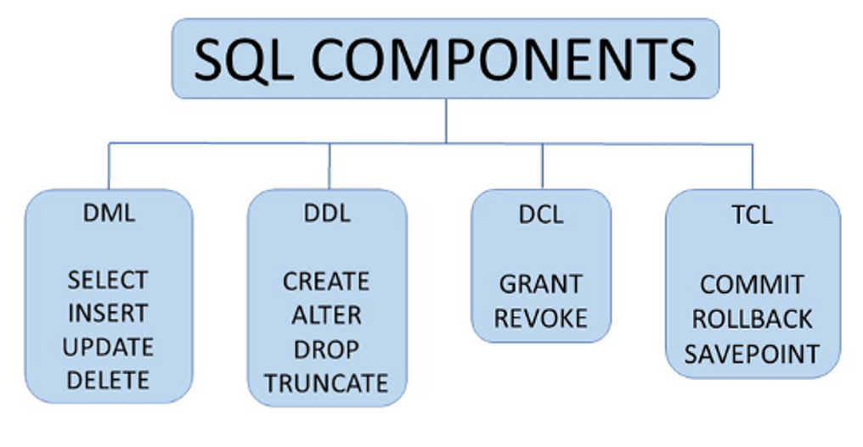
Structured Query Language (SQL)
Notes:
Data Manipulation Language (DML)
Data Definition Language (DDL)
Data Control Language (DCL)
Transaction Control Language (TCL)
GRANT and REVOKE; while Grant is used to give access to the data, Revoke is used to revoke the privileges granted
TCL — Transaction Control Language: TCL is the SQL component that includes commands able to manage DML transactions within a database. More specifically TCL includes commands like SAVEPOINT, COMMIT, and ROLLBACK.
SAVEPOINT is used to temporarily save a transaction and roll back to it whenever necessary through the command ‘rollback’. The syntax to use this command is:
update customer
set first_name = ‘Anthony’
where first_name = ‘Mary’
savepoint savepoint_name
ROLLBACK is used to undo the last transaction performed or to restore the database at the last save point. To do that (using the previous example), is sufficient to execute the following transaction:
rollback to savepoint savepoint_name
COMMIT instead, is used to permanently save a transaction change into a database. It is worth to note that after its execution, is not possible to perform a ‘rollback’ anymore so that’s why the ‘commit’ command should be used just when we are sure the code is correct; even, in this case, its syntax is very easy as it is necessary to write ‘commit’ after the transaction.
update customer
set first_name = ‘Anthony’
where first_name = ‘Mary’
commit

Slide 23
Structured Query Language (SQL)
DQL
SELECT
Notes:
Data Manipulation Language (DML)
Data Definition Language (DDL)
Data Control Language (DCL)
Transaction Control Language (TCL)

Slide 24
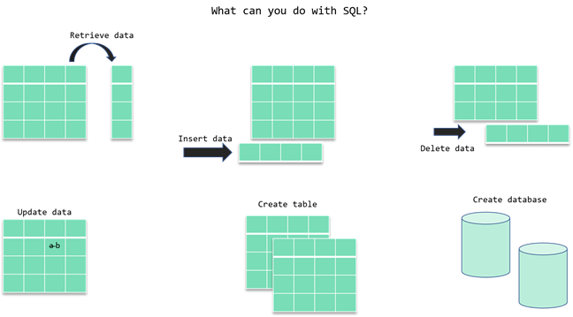
Structured Query Language (SQL)
CRUD
Notes:
SQL stands for Structured Query Language and used to communicate with relational databases. SQL is a declarative language, not a procedural language. You write a single SQL declaration and hand it to the DBMS. The DBMS then executes internal code, which is hidden from us.
CRUD operations:
Create Read Update and Delete
No need to talk about below for now.
But Boyce and Chamberlin teamed up to create a standard way of requesting information from these newfangled “relational databases.” They called it “Structured English Query Language” or “SEQUEL,” for short. It later got even shorter and became “Structure Query Language” or “SQL.”

Slide 25
SQL Language Elements
4

Slide 26
“The beginning of wisdom is the definition of terms.”
Socrates (470 – 399 B.C.)
Notes:
What I try to say here, if we can define the terms in a correct way, it’s easier for us to understand the the subjects we are working on. We tried to define the database, database management systems, SQL and relational database and database operations.

Slide 27
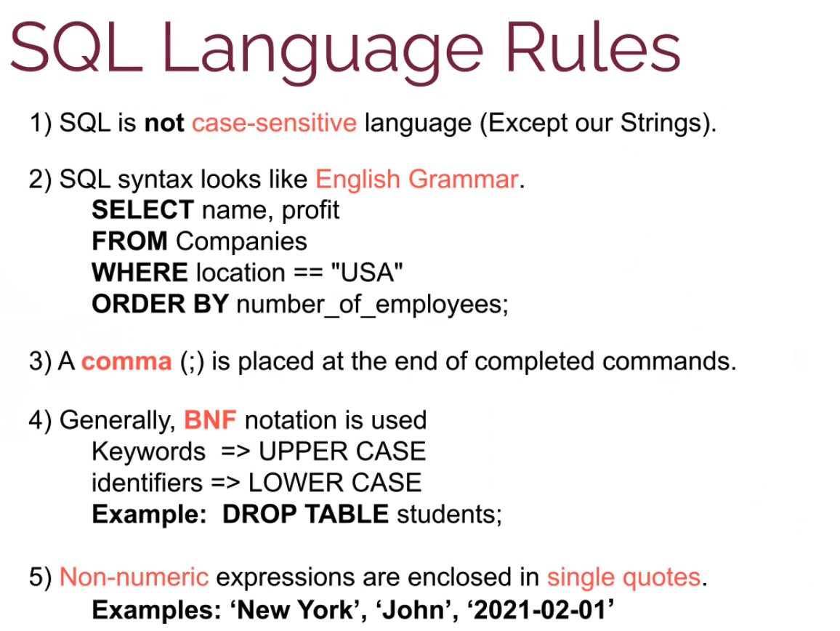
Notes:
What is BNF notation explain it with examples?
In computer science, Backus–Naur form (/ˌbækəs ˈnaʊər/) or Backus normal form (BNF) is a metasyntax notation for context-free grammars, often used to describe the syntax of languages used in computing, such as computer programming languages, document formats, instruction sets and communication protocols.

Slide 28
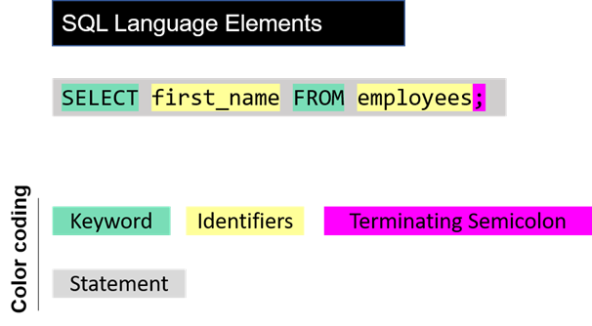
SQL Language Elements
(SQL Syntax)
Notes:
The whole command SELECT first_name FROM employees; is called statement. Let's breakdown of this statement. Herein SELECT, FROM words are keywords. They are special commands for SQL. first_name, employees are identifiers. SQL statements end with a semicolon (;). SQL Language Elements is also called SQL Syntax.
There are other SQL elements which we will cover later in the course. In the next part, we will introduce you SELECT statement in detail. We will learn the syntax and start to write our commands.

Slide 29
SELECT Statement

Slide 30
Introduction
You can retrieve rows from the columns of the table
by using SELECT statement.
SELECT statement is used with FROM keyword.
The SELECT statement is used to select data from a database.

Slide 31
SQL
Selecting column /columns/ all columns
SELECT column_name FROM table_name;
column_name(s)
*
Notes:
Basic Syntax
SQL statements start with a keyword like SELECT, INSERT, UPDATE, DELETE, etc. and all the statements end with a semicolon (;).
Semicolon at the end indicates that the statement is completed and ready to be executed.
SQL is also case insensitive, which means you can use both SELECT and select in your query. They mean the same thing for SQL.
Writing SQL commands in the upper-case is the most common and preferred style. But, you can write the same query in both ways.
White spaces and empty lines are ignored in SQL.

Slide 32
SQL
Notes:
!!! if column name include upper case you use table name between " "

Slide 33
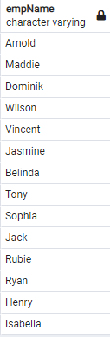
SQL
SELECT empname
FROM employees;

Slide 34
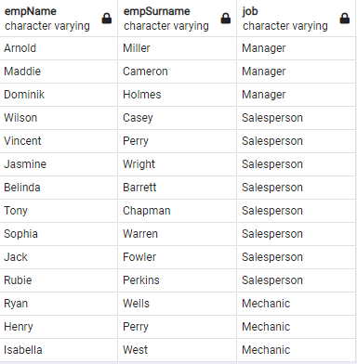
SQL
SELECT empname, empsurname, job
FROM employees;

Slide 35
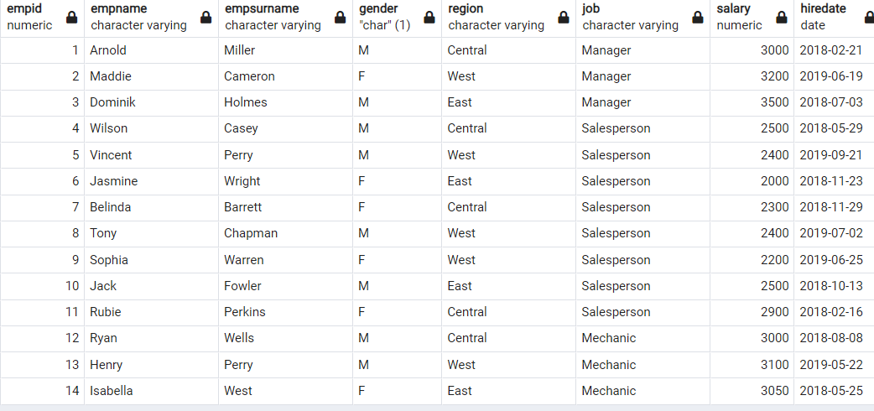
SQL
To retrieve all of the information from your table, an asterisk (*) character can be used after the SELECT
SELECT * FROM employees;

Slide 36
DISTINCT Clause

Slide 37
SQL
Columns in the tables may often contain some duplicate values, but you may only need the distinct values as a result. In such cases, we use the SELECT statement with the DISTINCT clause.

Slide 38
SQL
The SELECT DISTINCT is used to return only distinct (different/unique) values to eliminate duplicate rows in a result set. Here is the syntax of the DISTINCT clause:
SELECT DISTINCT column_name(s) FROM table_name;
Notes:
DISTINCT is always used in SELECT statements, and it provides the unique rows for all columns written in the SELECT statement. Therefore, you only use DISTINCT once in any particular SELECT statement.
SELECT DISTINCT önündeki tüm sütunlara etki eder. Burada bir yanlış anlama olmasın. Sadece önündeki sütuna etki eder şeklinde düşünebilirsiniz. Ama bu doğru değil.
Böyle bir yazım doğru değil.
SELECT DISTINCT column1, DISTINCT column2, DISTINCT column3 FROM table1;

Slide 39
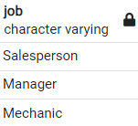
SQL
No Duplicated Rows
SELECT DISTINCT job
FROM employees;
Notes:
If a table has a column which has no duplicate records, it doesn’t make anything different when you use DISTINCT keyword
But if you use it for the columns with duplicate records, SQL brings you the each records once and removes the duplicates

Slide 40
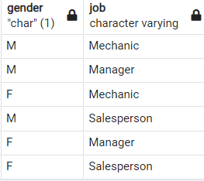
SQL
No Duplicated Rows
SELECT DISTINCT gender, job
FROM employees;

Slide 41
WHERE & LIMIT Clauses

Slide 42
SQL
The WHERE clause is used to filter records.
It allows you to define a specific search condition for the result set returned by a query.
SELECT column_name(s)
FROM table_name
WHERE condition(s);

Slide 43
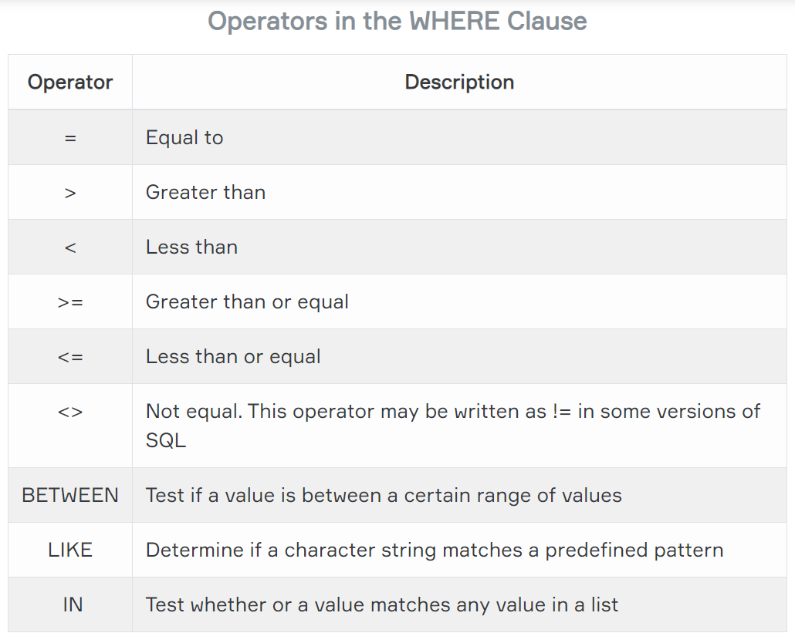
SQL
WHERE Clause – Operators

Slide 44
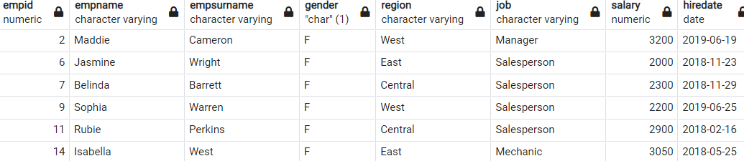
SQL
WHERE Clause
SELECT *
FROM employees
WHERE gender='F';
Notes:
SELECT *
FROM employees
WHERE gender='F';

Slide 45
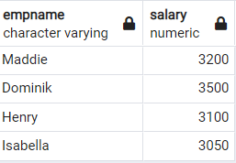
SQL
WHERE Clause
SELECT empname,salary
FROM employees
WHERE salary>3000;

Slide 46
LIMIT Clause
5

Slide 47
SQL
LIMIT Clause
The LIMIT clause is used to filter records.
It constrains the number of rows returned by a query.
SELECT column_name(s)
FROM table_name
LIMIT number_rows;
Notes:
The LIMIT clause is used to filter records. It constrains the number of rows returned by a query. Assume that your query returns one thousand rows. But you only want to see the first 10 rows in the result set. In such cases, we use LIMIT clause to obtain the desired output.

Slide 48
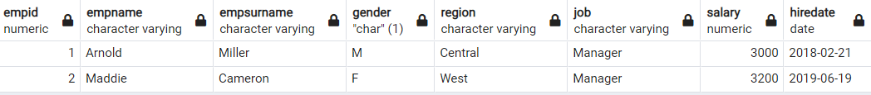
SQL
LIMIT Clause
SELECT *
FROM employees
LIMIT 2;

Slide 49
SQL
LIMIT Clause
We can also combine LIMIT with WHERE. In that case, LIMIT clause is placed after the WHERE clause.
SELECT column_name(s)
FROM table_name
WHERE condition(s);
LIMIT number_rows;

Slide 50
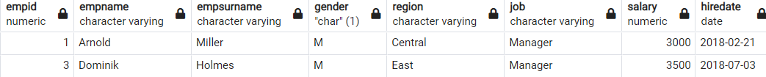
SQL
LIMIT Clause
SELECT *
FROM employees
WHERE gender='M'
LIMIT 2;

Slide 51


ORDER BY Clause

Slide 52
SQL
Order By Clause
In case you want to retrieve data in alphabetical or numeric order, we use ORDER BY keyword.
By default ORDER BY keyword sorts the records in ascending order.
Use the keyword DESC to sort the records in descending order. You can also use ASC explicitly to sort the data in ascending order.
SELECT column_name(s)
FROM table_name
ORDER BY column_name(s) ASC | DESC

Slide 53
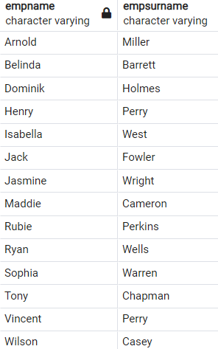
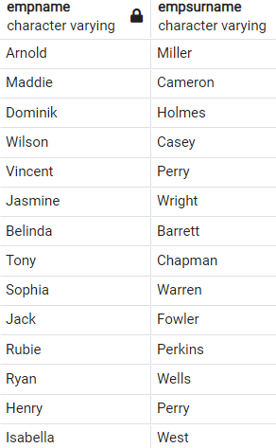
SQL
Order By Clause Ascending Order
SELECT empname,
empsurname
FROM employees
ORDER BY empname ASC

Slide 54
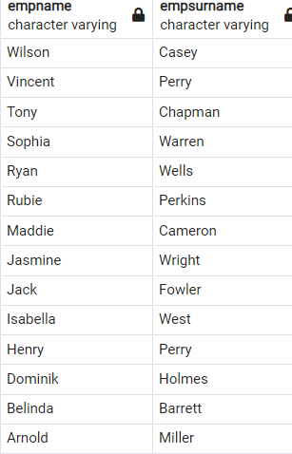
SQL
Order By Clause Descending order
SELECT empname,
empsurname
FROM employees
ORDER BY empname DESC

Slide 55
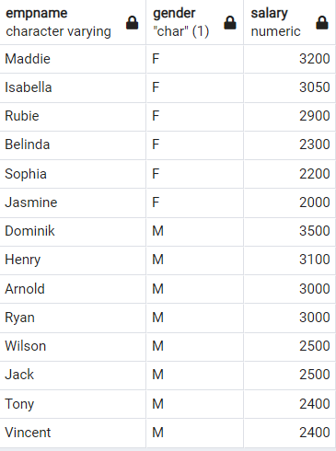
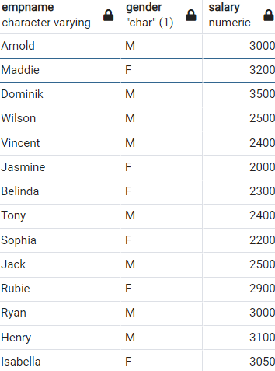
SQL
Order By Clause Multiple Columns
SELECT empname,
gender,
salary
FROM employees
ORDER BY gender,
salary DESC;
Notes:
Until now, we've sorted the column containing textual data.
It's time to sort numerical data in our table.
Who has the highest salary by gender?.
Let's write the query.
This time we don't want to retrieve all columns instead we want first name, gender name and salary.
We are now able to sort by one column using the ORDER BY keyword. In some cases, we may need to sort our data by two columns or more. To do this, separate the columns by a comma. Here is the syntax:
In this example we first sorted the data by gender, then we sorted by first salary.

Slide 56
SQL
Order By Clause With WHERE Clause
SELECT column_name(s) FROM table_name WHERE condition(s) ORDER BY column_name(s) ASC | DESC;
Beautifying
SELECT column_name(s)
FROM table_name
WHERE condition(s)
ORDER BY column_name(s) ASC | DESC;
Notes:
In this part, we will use ORDER BY with the WHERE clause. ORDER BY clause is placed after the WHERE clause.
Technically, any SQL statement can be written on a single line. However, it will become difficult to read when you start to write long queries. The solution in such cases is to organize the code, not just horizontally, but also vertically. This is called beautifying. Let's rewrite the syntax above.

Slide 57
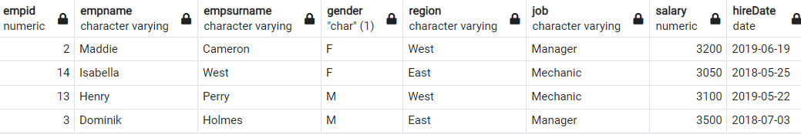
SQL
Order By Clause With WHERE Clause
SELECT *
FROM employees
WHERE salary>3000
ORDER BY empname
DESC;
Notes:
Assume that we try to find the employees whose salary is higher than $3000. Next, we will sort it by first_name in descending order.

Slide 58
AND, OR & NOT Operators

Slide 59
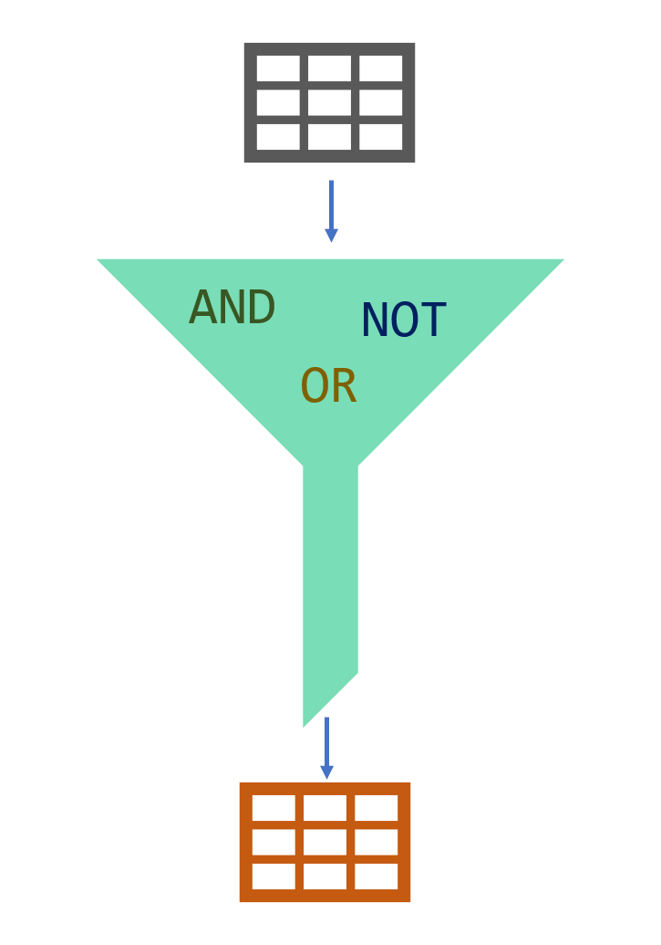
SQL
AND, OR & NOT Operators
In SQL, AND, OR & NOT keywords are called logical operators. Their purposes are filtering the data based on conditions.

Slide 60
SQL
AND Operator
The AND operator is used with the WHERE clause and combines multiple expressions. It returns only those records where both conditions (in WHERE clause) evaluate to True.
Syntax
WHERE left_condition AND right_condition

Slide 61
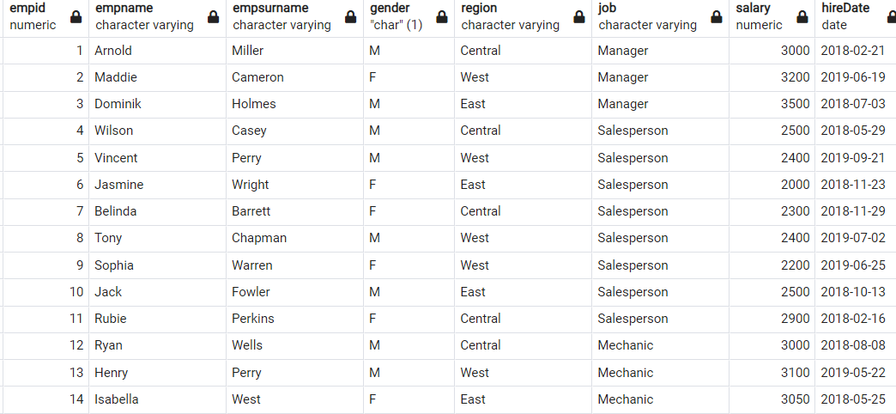
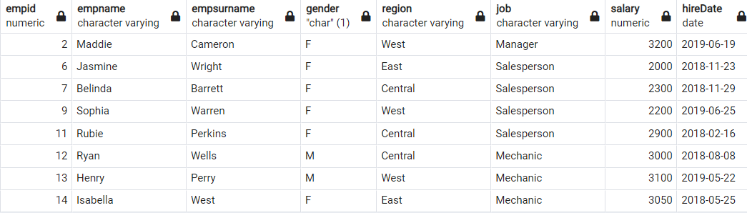
SQL
AND Operator
SELECT *
FROM employees
WHERE job='Mechanic' OR gender='F';

Slide 62
SQL
OR Operator
The OR operator is used with the WHERE clause and combines multiple expressions. It displays the record where either one of conditions (in WHERE clause) evaluates to True.
Syntax
WHERE left_condition OR right_condition

Slide 63
SQL
OR Operator
SELECT *
FROM employees
WHERE job='Manager' AND gender='M'

Slide 64
SQL
NOT Operator
The NOT operator is used to negate a condition in the WHERE clause. NOT is placed right after WHERE keyword. You can use it with AND & OR operators.
Syntax
WHERE NOT first_condition

Slide 65
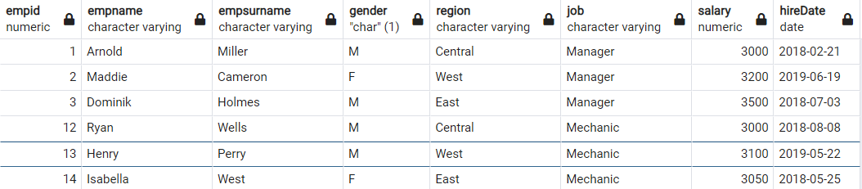
SQL
NOT Operator
SELECT *
FROM employees
WHERE NOT job='Salesperson'

Slide 66
BETWEEN OPERATOR

Slide 67
SQL
BETWEEN Operator
The BETWEEN operator is used for comparison in WHERE clauses. It's a comparison operator. You can use it to test if a value is in a range of values. If the value is in the specified range, the query returns all records fallen within that range.
WHERE test_expression BETWEEN low_expression AND high_expression
WHERE test_expression >= low_expression AND test_expression <= low_expression

Slide 68
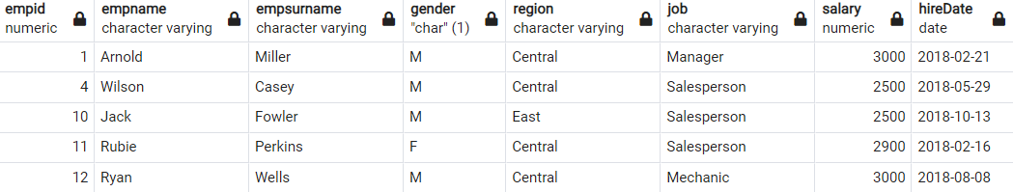
SQL
BETWEEN Operator
SELECT *
FROM employees
WHERE salary BETWEEN 2500 AND 3000;

Slide 69
SQL
NOT BETWEEN Operator
We can use NOT BETWEEN to negate the result of the BETWEEN operator. The following is the syntax:
WHERE test_expression NOT BETWEEN low_expression AND high_expression

Slide 70
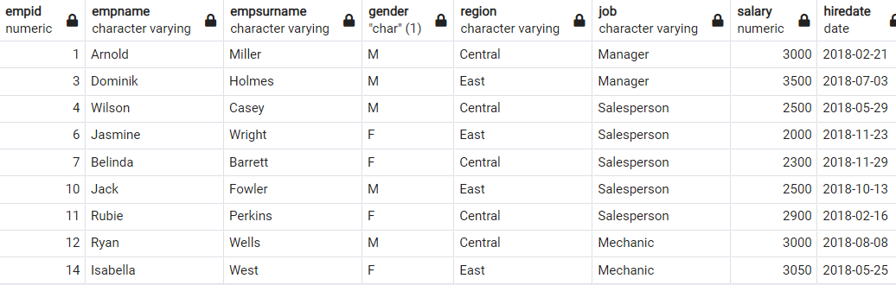
SQL
BETWEEN with Date Example
SELECT *
FROM employees
WHERE hiredate BETWEEN '2018-01-01' AND '2019-01-01'
Notes:
It's also possible to use the BETWEEN operator with dates. Please enclose your date values with single quote (') and use YYYY-MM-DD date format in your query.

Slide 71

Using BETWEEN is tricky for datetime! While BETWEEN is generally inclusive of endpoints, it assumes the time is at 00:00:00 (i.e. midnight) for datetime. So, the end point is exclusive. But, if you have just date, then BETWEEN behaves as expected.
TIP
Notes:
SELECT InvoiceDate FROM invoices
WHERE InvoiceDate BETWEEN '2009-01-01' AND '2011-12-27'
ORDER BY InvoiceDate DESC
-- LIMIT 1;
bu query’i çalıştıralım.
Ama bu time kısmı da varsa
------------------
SELECT * FROM company.employees
WHERE hire_date BETWEEN '2018-01-01' AND '2019-01-21';

Slide 72
IN OPERATOR

Slide 73
SQL
IN Operator
The IN operator is used to determine whether a value matches any value in a list. We use IN operator with WHERE clause.
WHERE column_name IN (velue_list)

Slide 74
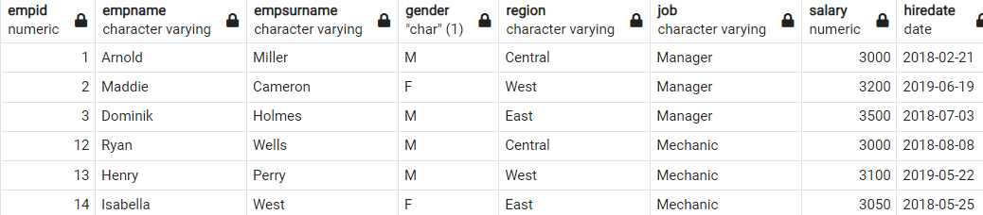
SQL
IN Operator
SELECT *
FROM employees
WHERE job IN ('Manager','Mechanic');

Slide 75
If you have a query in which you use many OR operators, consider using the IN operator instead. This will make your query more readable.
TIP

Slide 76
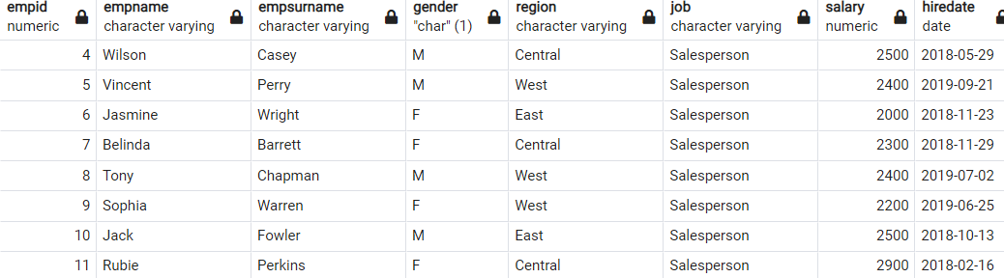
SQL
NOT IN Operator
SELECT *
FROM employees
WHERE job NOT IN ('Manager','Mechanic');

Slide 77
LIKE OPERATOR

Slide 78
SQL
LIKE Operator
After LIKE keyword, we construct a pattern. SQL provides two special characters for constructing patterns. These are also called wildcards.
Percent (%): The % character matches any sequence of zero or more characters.
Underscore ( _ ): The _ character matches any single character
SELECT column_name(s)
FROM table_name
WHERE column_name LIKE (velue_list)

Slide 79
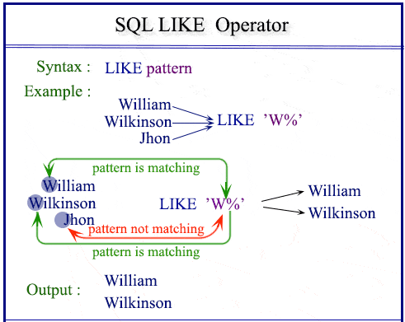
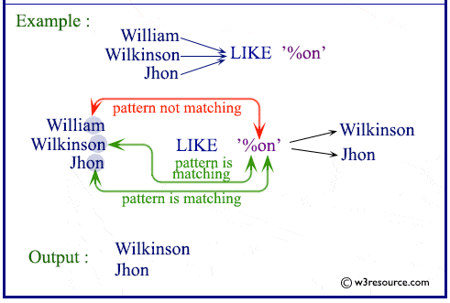
SQL
LIKE Operator

Slide 80
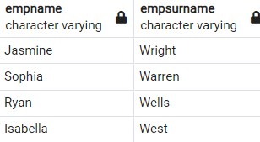
SQL
LIKE Operator
SELECT empname,empsurname
FROM employees
WHERE empsurname LIKE 'W%';
Notes:
SELECT empname, empsurname
FROM employee
WHERE empsurname LIKE 'W%';

Slide 81
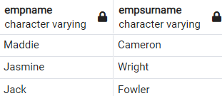
SQL
LIKE Operator
SELECT empname,empsurname
FROM employees
WHERE empname LIKE '_a%';
Notes:
SELECT empname,empsurname
FROM employees
WHERE empname LIKE '_a%';

Slide 82
Aggregate Functions

Slide 83
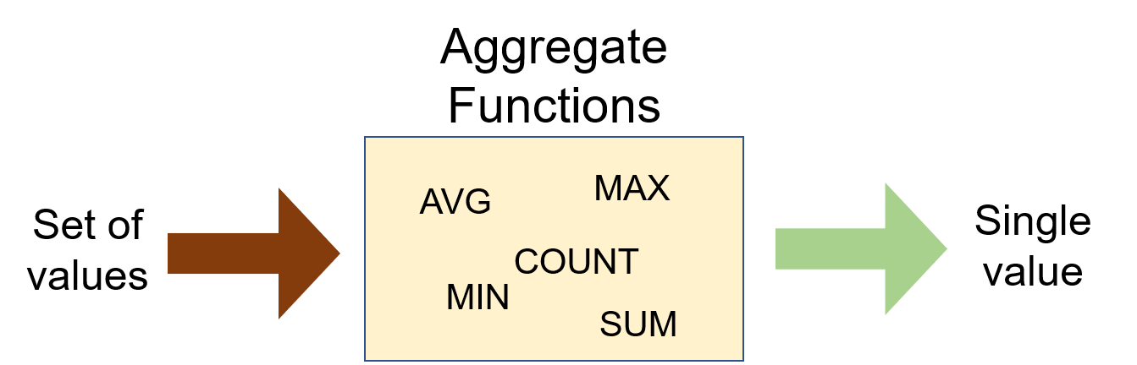
SQL What is an aggregate function?
Aggregate functions are functions that take a collection of values as input and return a single value
Notes:
Aggregate functions are functions that take a collection of values as input and return a single value. SQL has five built-in aggregate functions:
COUNT (Count)
MIN (Minimum)
MAX (Maximum)
SUM (Total)
AVG (Average)

Slide 84
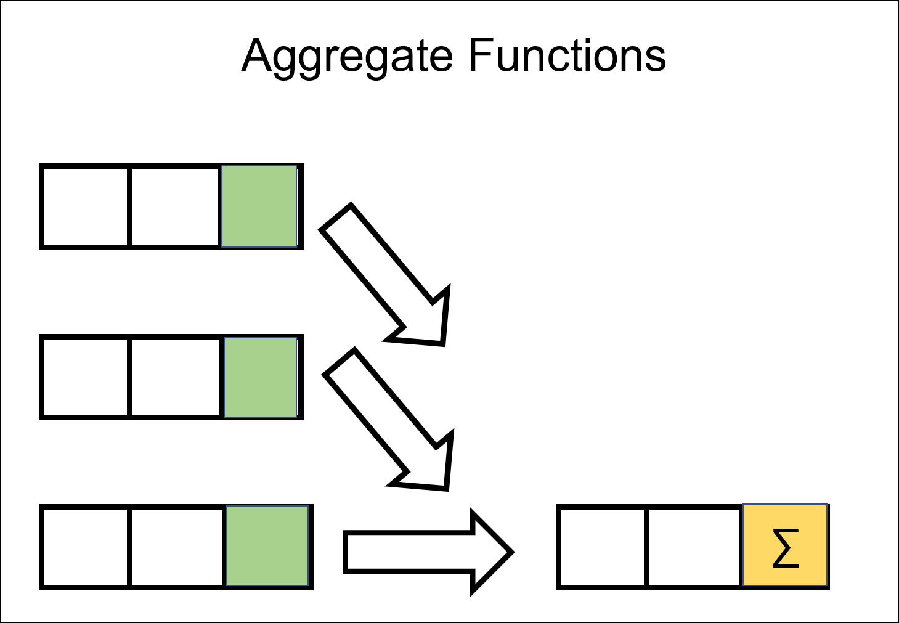
SQL What is an aggregate function?
SUM and AVG → numeric values
MIN, MAX, COUNT → numeric & non-numeric (strings, date, etc.)
We will learn GROUP BY clause and HAVING clause later.
What is NULL?
Notes:
SUM and AVG functions must take only numeric values as input. However, the other functions (MIN, MAX, COUNT) may take non-numeric values (strings, date, etc.) as input other than numeric values.
An aggregate function performs a calculation one or more values and returns a single value. The aggregate function is often used with the GROUP BY clause and HAVING clause of the SELECT statement.
Before we dive into the aggregate functions, we should learn an important concept which is NULL.

Slide 85
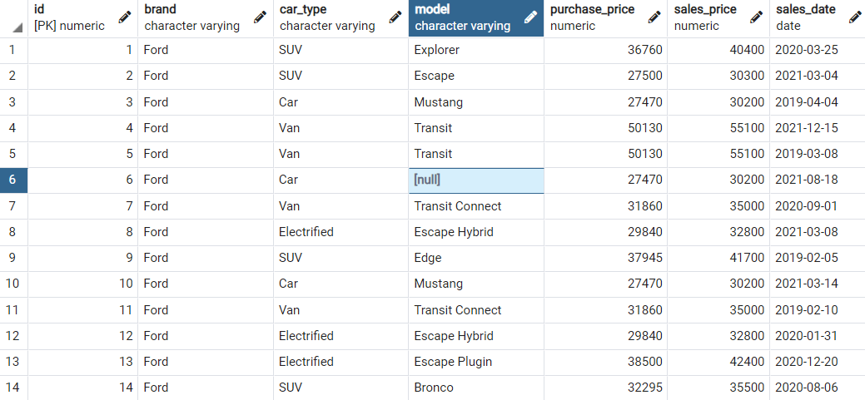
SQL What is NULL?
NULL means no data and is a special value in SQL.
It shows us that a piece of information is unknown or missing or not applicable.
Notes:
For instance, let's assume that we have a song database and we don't know the writers of some of them.
We don't have that information. So, to store these unknown songwriters in a database table, we must use NULL.
If a table has NULL value, then it will be displayed as NULL.

Slide 86

SQL What is NULL?
NULL value represents the unknown value or missing value or not applicable.
NULL is not equal to zero or empty string.
NULL is not equal to itself.
Notes:
It's important to understand what nulls mean and to know how to work with them. They are often ignored in our aggregation functions.
In fact, it is undesirable for the data to be null in the tables, and it is usually tried to get rid of the null expressions in analysis studies.
A field with a NULL value is a field with no value.
If a field in a table is optional, it is possible to insert a new record or update a record without adding a value to this field. Then, the field will be saved with a NULL value.
The following expression returns 0: NULL = NULL, This is because two unknown information cannot be comparable.
Alright, let's start with COUNT function.

Slide 87
COUNT Function
2

Slide 88
SQL COUNT Function
We use COUNT function to count the numbers of records (a.k.a row) in a table.
SELECT COUNT (column_name)
FROM table_name;
Notes:
We use COUNT function to count the numbers of records (a.k.a row) in a table. Here is the syntax of the COUNT function:
Use COUNT keyword immediately after SELECT keyword. Then specify the column on which you want to operate in parentheses

Slide 89
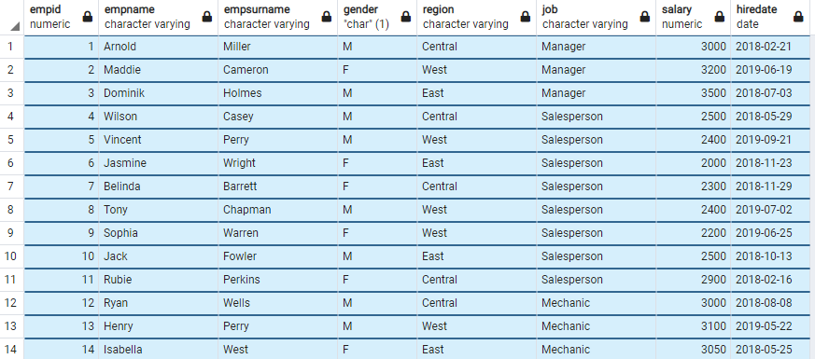
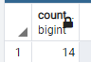
COUNT Function
How many employees does the company have?
SELECT COUNT (*)
FROM employees;
Notes:
Select count(*) from employees;

Slide 90
COUNT Function
There is another special character returning the number of rows in a table. That is * character. Use it inside the COUNT function as COUNT(*).

Slide 91
COUNT Function
An important point for COUNT(*) function is that the result table includes NULL. If you want the number of non-null values, use the syntax: COUNT(column_name).
Notes:
But this way it counts everything in the column, even null data
select count(*)
from Tracks → returns 3503 rows
select count(composer)
from Tracks --> returns 2525 rows
count(.....) removes the null ones
if I want to see how many values are there in the composer field, use this one
select count(*)
from Tracks
where composer is null --> number of null values in composer column--978
(where composer = null --not works like that)
select count(*)
from Tracks
where composer is not null --> number of not null values in composer column --2528

Slide 92
AS (Alias) Keyword
We can customize the column name or table name using AS keyword. AS is used to rename a column or table with an alias.
This is the syntax for aliasing a column name:
column_name [AS] alias_name
---------------------------------------------------------
This is the syntax for aliasing a table name:
table_name [AS] alias_name
Notes:
ALIASES can be used to create a temporary name for columns or tables.
COLUMN ALIASES are used to make column headings in your result set easier to read.
TABLE ALIASES are used to shorten your SQL to make it easier to read or when you are performing join tables

Slide 93
AS (Alias) Keyword
AS keyword is optional. Most programmers specify the AS keyword when aliasing a column name, but not when aliasing a table name.
TIP

Slide 94
COUNT DISTINCT
3

Slide 95
COUNT DISTINCT
In some cases, we may want unique values. In those cases, we use COUNT DISTINCT function.
Syntax
COUNT (DISTINCT column_name)
Notes:
select count (distinct AlbumId)
from Tracks
So we have 347 different albums out of 3503 tracks

Slide 96
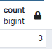
COUNT DISTINCT
How many unique fields are there in the employees table?
SELECT COUNT (DISTINCT job)
FROM employees;
Notes:
there are 6 unique or distinct fields in which students may enroll. COUNT(DISTINCT field) returns the number of unique and non-null values in column field.
select field, count(field)
from student_info
group by field

Slide 97
MIN and MAX

Slide 98
MIN Function
MIN function returns the minimum value in the selected column. The MIN function ignores the NULL values.
Syntax
SELECT MIN (column_name)
FROM table_name;
Notes:
The MIN function ignores the NULL values. Thus, it retrieves the non-NULL minimum value in the selected column.

Slide 99
MIN Function
What is the lowest wage in the company?
SELECT MIN (salary)
FROM employees;

Slide 100
MAX Function
MAX function returns the maximum value in the selected column.
Syntax
SELECT MAX (column_name)
FROM table_name;
Notes:
MAX function returns the maximum value in the selected column.
With the MAX function, you can find the highest salary among the employees, the most expensive products, the longest track, the newest dates etc.

Slide 101
MAX Function
What is the last hired employees’s date?
SELECT MAX (hiredate)
FROM employees;
Notes:
The MIN function can also be used with dates. For instance, display the earliest hired employee's date.

Slide 102
SUM and AVG

Slide 103
SUM Function
SUM function returns the sum of a numeric column.
Syntax
SELECT SUM (column_name)
FROM table_name;

Slide 104
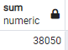
SUM Function
What is total amount salary of the employees?
SELECT SUM (salary)
FROM employees;
Notes:
What is total amount salary of the male employees?
SELECT SUM(salary) as male_salary
FROM employees
WHERE gender=’Male’

Slide 105
AVG Function
2

Slide 106
AVG Function
AVG function calculates the average of a numeric column.
Syntax
SELECT MAX (column_name)
FROM table_name;

Slide 107
AVG Function
What is the average salary of the employees?
SELECT AVG (salary)
FROM employees;

Slide 108
GROUP BY Clause
1

Slide 109
GROUP BY Clause
The GROUP BY clause groups the rows into summary rows. It returns one value for each group and is typically used with aggregate functions (COUNT, MAX, MIN, SUM, AVG).
 |  | Gender
 |  | Male
 |  | Male
 |  | Female
 |  | Female
COUNT(Gender)
4
COUNT(Gender)
WHERE Gender = ‘Male’
2
COUNT(Gender)
WHERE Gender = ‘Female’
2
Notes:
There are some cases where we may need to apply the aggregate function not only to a selected group of rows. In the previous parts, we found the total amount of salaries of male and female employees separately. What if want to show them in the same result table grouped by their gender. In such cases, we use GROUP BY statement. In case a WHERE clause is used, the GROUP BY clause should come after the WHERE clause. We specify the column or a list of comma-separated columns right after the GROUP BY. Any nonaggregate expression in the SELECT must be included in the GROUP BY clause.

Slide 110
GROUP BY Clause
GROUP BY returns only one result per group of data.
GROUP BY Clause always follows the WHERE Clause.
GROUP BY Clause always precedes the ORDER BY.
SELECT column1,aggregate_function(column2)
FROM tabel_name
GROUP BY column_1;
Notes:
We've mentioned that the GROUP BY clause is often used with aggregate functions. Now, let's see how it is.

Slide 111
GROUP BY with COUNT Function
2

Slide 112

GROUP BY with COUNT Function
What is the number of employees per gender?
SELECT gender, COUNT (gender)
FROM employees
GROUP BY gender;
Notes:
you remember before, we used with “order by” clause to sort
select *
from employees
order by gender DESC

Slide 113
GROUP BY Clause
The GROUP BY clause groups results before calling the aggregate function. This allows you to apply aggregate function to groups than the entire query.
gender
Male
Male
Male
Male
Male
Male
gender | COUNT(gender)
Male | 6
Female | 4
Female
Female
Female
Female

Slide 114

GROUP BY with COUNT Function
What is the number of employees working as a salesperson broken by gender?
SELECT gender, COUNT (job)
FROM employees
WHERE job='Salesperson'
GROUP BY gender;

Slide 115
GROUP BY Clause
WHERE clause operates on the data before the aggregation.
WHERE clause happens before the GROUP BY clause.
Only the rows that meet the conditions in the WHERE clause are grouped.

Slide 116
GROUP BY with MIN&MAX Functions
3

Slide 117

GROUP BY with MIN&MAX Functions
Let’s find the minimum salaries of each gender group using the MIN function.
SELECT gender, MIN (salary)
FROM employees
GROUP BY gender;

Slide 118

GROUP BY with MIN&MAX Functions
Similarly, we can find the maximum salaries of each group using the MAX function. You may also use the ORDER BY clause to sort the salaries in descending or ascending order. The ORDER BY follows GROUP BY. For instance, sort the maximum salaries in descending order.
SELECT gender, MAX (salary) AS maxsalary
FROM employees
GROUP BY gender
ORDER BY maxsalary DESC;

Slide 119
GROUP BY with SUM&AVG Functions
4

Slide 120

GROUP BY with SUM&AVG Functions
Let’s calculate the total salaries of each group (gender).
SELECT gender, SUM (salary) AS totalsalary,
AVG (salary) AS avgsalary FROM employees
GROUP BY gender;
Notes:
In the previous part, we have learned how to use MIN and MAX functions with the GROUP BY clause. In this part, we will continue with SUM and AVG functions. Let's go with the same scenario. In this case, we will calculate the total salaries of each group (gender).

Slide 121


Query Time

Slide 122

Entity Relationship Diagram
Notes:
Here is ERD Diagram of the dijital müzik mağazası database. do u know what is ERD by the way?
Entity Relationship Diagram, also known as ERD, ER Diagram or ER model, is a type of structural diagram for use in database design. An ERD contains different symbols and connectors that visualize two important information: The major entities within the system scope, and the inter-relationships among these entities.And that's why it's called "Entity" "Relationship" diagram (ERD)!
11 tane tablodan oluşmaktadır.

Slide 123
Write a query that returns the track name using tracks table.
Notes:
SELECT Name FROM tracks;

Slide 124
Write a query that returns track name and its composer using tracks table.
Notes:
SELECT Name, Composer FROM tracks;

Slide 125
Write a query that returns all columns of albums table.
Notes:
SELECT AlbumId, Title, ArtistId FROM albums;

Slide 126
Write a query that returns columns of tracks table.
Notes:
SELECT * FROM tracks;
Burada tracks tablosundaki tüm sütun isimlerini teker teker yazmaktansa asterisk karakteri ile tüm sütunları seçebiliriz.

Slide 127
Find the name of composers of each track using tracks table.
Notes:
SELECT DISTINCT Composer FROM tracks;
Örneğin, Sadece Composer, yani bestecileri görmek istediniz. Bunun için sadece Select Composer FROM tracks; demenizi size gereksiz birçok
kendini tekrar eden verileri gösterecek.
Duplicate verileri bulmada veya aynı kelimenin farklı yazılışlarını tespit edip bunları düzeltebelirsiniz.
Örneğin, Şehir isminde bir sütununuz var.
Burada İSTANBUL ifadesi
İst.
İSTANBUL şeklinde farklı yazılmış.

Slide 128
Write a query that return distinct AlbumId, MediaTypeId pair
Notes:
SELECT DISTINCT AlbumId, MediaTypeId FROM tracks; örneğini anlat. SELECT DISTINCT
Be careful. There is a null value in the column. It also returns.
If a column has multiple NULL values and you use the DISTINCT clause for that column, SQLite keeps only one NULL value because DISTINCT treats all NULL values as the same value.
SELECT DISTINCT AlbumId, MediaTypeId FROM tracks;

Slide 129
Find the track names of Jimi Hendrix.
Notes:
Answer:
SELECT Name FROM tracks
WHERE Composer = 'Jimi Hendrix';

Slide 130
Find all the info of the invoices of which total amount is greater than $10.
Notes:
Answer:
SELECT * FROM invoices
WHERE Total > 10;

Slide 131
Find all the info of the invoices of which total amount is greater than $10. Just return the first 4 rows.
Notes:
Answer:
SELECT * FROM invoices
WHERE Total > 10
LIMIT 4;

Slide 132
Find all the info of the invoices of which total amount is greater than $10. Then sort them by the total amount in descending order.
Notes:
Answer:
SELECT *
FROM invoices
WHERE Total > 10
ORDER BY Total DESC;

Slide 133
Find all the info of the invoices of which billing country is not USA. Then sort them by the total amount in ascending order.
Notes:
Answer:
SELECT *
FROM invoices
WHERE NOT BillingCountry = USA
ORDER BY Total ASC
LIMIT 1;

Slide 134
Find the newest invoice date among the invoice dates between 2009 and 2011.
invoi
Notes:
Answer:
SELECT InvoiceDate
FROM invoices
WHERE InvoiceDate BETWEEN '2009-01-01' AND '2012-01-01'
ORDER BY InvoiceDate DESC
LIMIT 1;
Burada LIMIT 1 yap.Daha sonra -- yorum yap. Onu anlat. Yorumlar önemli.
You will notice that using BETWEEN is tricky for dates! While BETWEEN is generally inclusive of endpoints, it assumes the time is at 00:00:00 (i.e. midnight) for dates. This is the reason why we set the right-side endpoint of the period at '2012-01-01'.

Slide 135
Find the first and last name of the customers who gave an order from Belgium, Norway, Canada and USA.
Notes:
SELECT FirstName, LastName FROM customers
WHERE Country IN ('Belgium', 'Norway', 'Canada', 'USA')

Slide 136
Find the track names of Bach.
Notes:
Answer:
SELECT Composer, Name FROM tracks
WHERE Composer LIKE '%Bach';

Slide 137
How many invoices are in the digital music store?
Notes:
Answer:
SELECT COUNT(*)
FROM invoices;

Slide 138
How many composers are there in the digital music store?
Notes:
Answer:
SELECT COUNT(DISTINCT Composer)
FROM tracks;

Slide 139
Find the track name having the minimum duration.
Notes:
Answer:
SELECT Name, MIN(Milliseconds)
FROM tracks;

Slide 140
Find the track name having the maximum duration.
Notes:
Answer:
SELECT Name, MAX(Milliseconds)
FROM tracks;

Slide 141
How much money did our store earn?
Notes:
Answer:
SELECT SUM(Total)
FROM invoices;
************
Let’s get further and try to find how much money we had in 2010 or any other year
To encourage students to search themselves on Google, lets discuss

Slide 142
Find the tracks having duration bigger than the average duration.
Notes:
Answer:
SELECT avg(Milliseconds)
FROM tracks;
then use the result in second query
select * from tracks where Milliseconds > 393599.212103911
We will learn subqueries later and you don’t have to run 2 different queries.
You will be able to use the result from one query and use it in the other query

Slide 143
Find the total number of each composer’s track. Your result will include name of the composer and number.
Notes:
Answer:
SELECT Composer, COUNT(*)
FROM tracks
GROUP BY Composer;
SELECT Composer, COUNT(composer)
FROM tracks
GROUP BY Composer;
SELECT Composer, COUNT(composer)
FROM tracks
WHERE Composer IS NOT NULL
GROUP BY Composer;

Slide 144
How many customers do we have from each country? Your result will include name of the country and number.
Notes:
Answer:
SELECT Country, COUNT(*) AS no_of_country
FROM customers
GROUP BY Country
-- ORDER BY no_of_country DESC
-- LIMIT 1;
Country-City tuple
SELECT Country, City, COUNT(*) AS no_of_country
FROM customers
GROUP BY Country, City;
what if you want to bring the table showing the total (average) amounts for per country
SELECT BillingCountry, SUM/AVG(total) as TotalDollars
FROM invoices
GROUP BY BillingCountry

Slide 145
Find the minimum duration of track for each album. Your result will include album id and min duration.
Notes:
Answer:
SELECT AlbumId, MIN(Milliseconds)
FROM tracks
GROUP BY AlbumId;
------------------------------------
SELECT AlbumId, Composer, MIN(Milliseconds)
FROM tracks
GROUP BY AlbumId, Composer;

Slide 146
Find the total amount of invoice for each country. Your result will include country name and total amount.
Notes:
Answer:
SELECT BillingCountry, SUM(Total)
FROM invoices
GROUP BY BillingCountry;

Slide 147



Drag your dot to how you are feeling:
Keep going, I understand
I’m a little confused
Stop, I need help!
Notes:
Temperature Check
WIth this slide, you can get a quick idea of how your students are feeling about the pace of the lesson. Getting consensus before moving on helps ensure everyone is still with you, and identify the students who might need extra attention.
🍐 This is a Pear Deck Draggable™ Slide.
🍐 To edit the type of question, go back to the "Ask Students a Question" in the Pear Deck sidebar.

Slide 148

THANKS!
Any questions?

